Slide 1

DEPARTMENT OF COMPUTER SCIENCE & ENGINEERING
ACHARYA INSTITUTE OF TECHNOLOGY SOLADEVANAHALLI, BENGALURU-560107
Academic Project Presentation on
“Comparison of Contactless and Contact based Fingerprints”
Presented by:
1.Yeshwanth C (1AY20CS190)
2.Krishang Gowda (1AY20CS199)
3.Charan N (1AY21CS405)
4.Tharun Reddy R (1AY21CS416)
Under the guidance of:
Dr. Ajith Padyana
H.O.D
Department of CSE
AIT

Slide 2
AGENDA
Introduction
Problem Statement
Literature survey
Functional & Non-Functional Requirements
Software & Hardware Requirements
Proposed Methodology
Flowchart
Testing Results
Conclusion & Future work
References
2

Slide 3
INTRODUCTION
Contact-based fingerprint systems are susceptible to degradation of scanning surfaces over time, resulting in decreased accuracy and reliability. Contactless fingerprint systems, utilizing technologies such as capacitive or optical sensors, mitigate this issue by capturing fingerprint data without physical contact, ensuring more consistent and durable performance.

Slide 4
PROBLEM STATEMENT
To enhance recognition accuracy in identifying fingerprint images, thereby improving the efficiency and precision of biometric identification processes.

Slide 5
LITERATURE SURVEY
S.N | PAPER TITLE & PUBLICATION DETAILS | NAME OF THE AUTHORS | TECHNICAL IDEAS / ALGORITHMS USED IN THE PAPER & ADVANTAGES | SHORTFALLS/ DISADVANTAGES & SOLUTION PROVIDED BY THE PROPOSED SYSTEM
1 | Contactless Fingerprint Recognition Using Deep Learning—A Systematic Review | A M Mahmud Chowdhury and Masudul Haider Imtiaz | Variance modified Laplacian of gaussian, image segmentation and blur reduction, DNN | Deep Learning increase accuracy, Large scale dataset, cloud based storage
2 | A Contactless Fingerprint Recognition System | Aman Attrish, Nagasai Bharat, Vijay Anand, Member | Siamese CNN, Adaptive mean thresholding | image sensors, siamese convolutional neural, providing real-time recognition
6

Slide 6
S.N | PAPER TITLE & PUBLICATION DETAILS | NAME OF THE AUTHORS | TECHNICAL IDEAS / ALGORITHMS ACQUIRED FROM THE PAPER USEFULL IN DESIGNING THE PROPOSED SYSTEM | SHORTFALLS/DISAD VANTAGES & SOLUTION PROVIDED BY THE PROPOSED SYSTEM
3 | A CNN-based Framework for Comparison of Contactless to Contact-based Fingerprints | Chenhao Lin, Ajay Kumar | Gabor filter and adaptive histogram equalization | cross-fingerprint comparison problem using deep learning
4 | An overview of touchless 2D fingerprint recognition | Jannis Priesnitz , Christian Rathgeb, Nicolas Buchmann, Christoph Busch and Marian Margraf | Siamese CNN, Variance modified Laplacian of gaussian | incorporating state-of-the-art algorithms for feature extraction, matching, and quality assessment, the proposed system can address the challenges
6
Department of CS&E, Acharya Institute of Technology
28-May-24

Slide 7
S.N | PAPER TITLE & PUBLICATION DETAILS | NAME OF THE AUTHORS | TECHNICAL IDEAS / ALGORITHMS ACQUIRED FROM THE PAPER USEFULL IN DESIGNING THE PROPOSED SYSTEM | SHORTFALLS/DISAD VANTAGES & SOLUTION PROVIDED BY THE PROPOSED SYSTEM
5 | Matching of Contact and Contactless Fingerprint Using CNN model | T M Geethanjali, Divyashree M D, Monisha S K, Sahana M K | Sequential CNN, adaptive histogram equalization | Limited Research on Matching Contactless and Contact-Based Fingerprints
7
Department of CS&E, Acharya Institute of Technology
28-May-24

Slide 8
FUNCTIONAL REQUIREMENTS
Image Preprocessing
Data Loading
Pair Generation
CNN Model
Training
Evaluation
Visualization

Slide 9
NON-FUNCTIONAL REQUIREMENTS
Performance
Accuracy
Scalability
Robustness

Slide 10
SOFTWARE REQUIREMENTS
Programming Language: Python
Deep Learning Framework: TensorFlow
Image Processing Libraries: OpenCV
Model Visualization Tools: Matplotlib
Validation Metric Calculation: scikit-learn

Slide 11
HARDWARE REQUIREMENTS
Central Processing Unit (CPU)
Graphics Processing Unit (GPU)
Random Access Memory (RAM)
Storage (SSD)
Department of CS&E, Acharya Institute of Technology

Slide 12
PROPOSED METHODOLOGY
1. Data Preprocessing:
Loading contact-based and contactless fingerprint images.
Preprocess images by converting them to grayscale performing histogram equalization, adaptive thresholding, resizing.
2. Pair Generation:
Generating pairs of fingerprint images with corresponding labels.
Randomly select pairs from the dataset for training and testing.
3. Siamese Network Model Definition:
Defining a Siamese neural network model architecture using TensorFlow and Keras.
The model consists of convolutional layers followed by max-pooling, flattening, and dense layers.

Slide 13
4. Model Training:
Compiling the Siamese model with appropriate optimizer and loss function.
Train the model on the generated pairs using training data.
Monitor training progress using callbacks like EarlyStopping.
5. Model Evaluation:
Evaluate the trained model on the test data to assess its performance.
Compute metrics such as accuracy, precision, recall, and F1-score.
Generate a classification report and visualize the confusion matrix to understand the model's predictions.

Slide 14
PROJECT MODULES
1. Data Preprocessing Module:
Performs preprocessing tasks such as converting images to grayscale, histogram equalization, adaptive thresholding, resizing.
2. Pair Generation Module:
Generates pairs of fingerprint images with corresponding labels indicating similarity or dissimilarity.
Randomly selects pairs from the dataset for training and testing.
3. Siamese Network Model Definition Module:
Defines the architecture of the Siamese neural network model using TensorFlow and Keras.
Comprises convolutional layers, max-pooling, flattening, and dense layers.

Slide 15
PROJECT MODULES
4. Model Training Module:
Compiles the Siamese model with an appropriate optimizer and loss function.
Trains the model on the generated pairs using training data.
Monitors training progress using callbacks such as EarlyStopping.
5. Model Evaluation Module:
Evaluates the trained model on the test data to assess its performance.
Computes metrics such as accuracy, precision, recall, and F1-score.
Generates a classification report and visualizes the confusion matrix to understand the model's predictions.

Slide 16
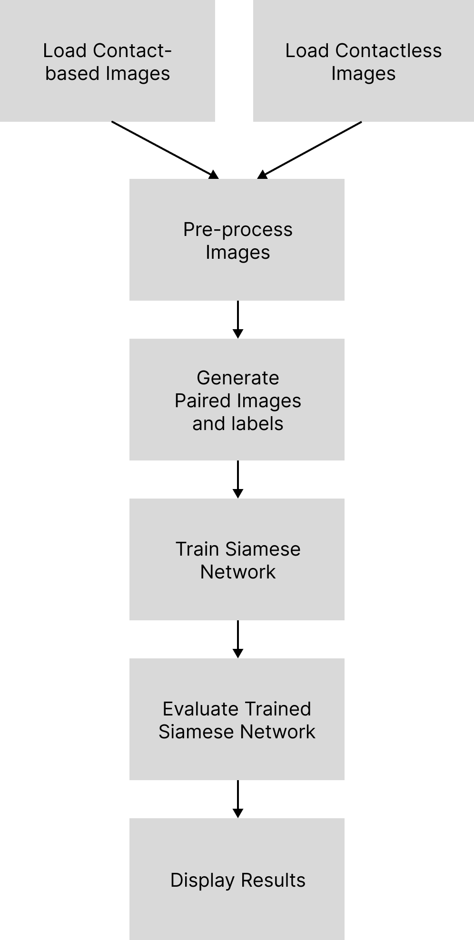
FLOWCHART

Slide 17
DETAILS OF PROJECT DEMONSTRATION
Data Loading and Preprocessing:
Load contact-based fingerprint images and contactless fingerprint images.
Preprocess images by equalizing histogram, applying adaptive thresholding, resizing.
Split data into training and testing sets.
2. Pair Generation:
Generate pairs of images with their corresponding labels (1 for similar pairs, 0 for dissimilar pairs).
Randomly select images from the dataset to form pairs.

Slide 18
DETAILS OF PROJECT DEMONSTRATION
3. Model Training:
Define a Siamese neural network model architecture with convolutional and dense layers.
Compile the model with an optimizer, loss function, and evaluation metrics.
Train the model on the generated pairs of images using training data.
Monitor training progress with epoch-wise accuracy and loss.
4. Model Evaluation:
Evaluate the trained model on the test data to assess its performance.
Compute accuracy, precision, recall, F1-score, and generate a classification report.
Plot a confusion matrix to visualize the model's performance in terms of true positive, false positive, true negative, and false negative predictions.

Slide 19
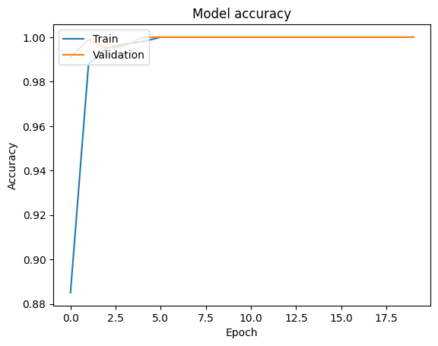
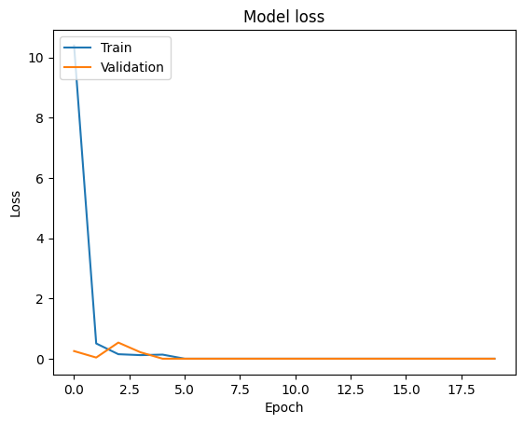
TESTING RESULTS
Accuracy plot
Loss plot
From the graph, we can see the training accuracy quickly reaches near perfection (close to 1.0), while the validation accuracy lags behind, reaching a plateau at a lower value.
From the graph, we can see both the training and validation loss decrease over time, which is a good sign that the model is learning from the training data.

Slide 20
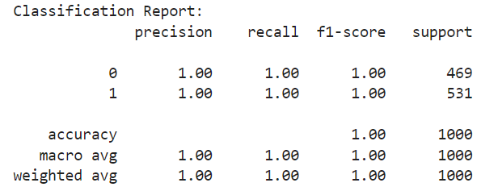
TESTING RESULTS
Precision: The precision is 1.00 for both classes, which means that there were no false positives.
Recall (Sensitivity): The recall is 1.00 for both classes, which means that there were no false negatives.
F1-Score: An F1 Score of 1 indicates perfect precision and recall.
Support: There are 469 instances of class 0 and 531 instances of class 1.
The classification report indicates that the model has achieved perfect precision, recall, and F1-score on both classes. This suggests that the model has achieved excellent performance on the data it was evaluated on.

Slide 21
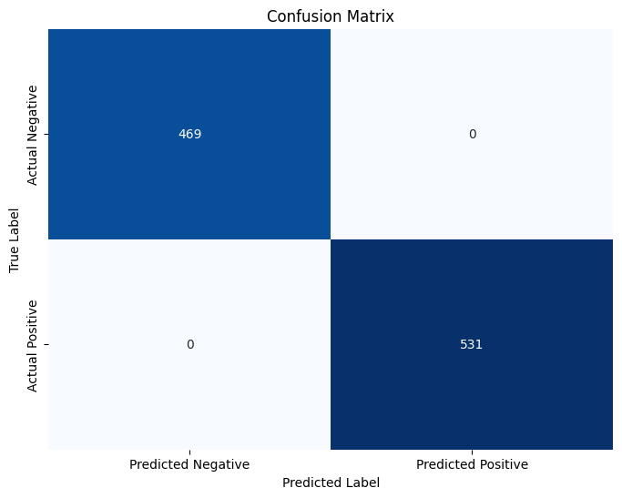
TESTING RESULTS
True Negatives (TN): The top left square of the matrix represents the count of true negatives - cases when the actual class of the instance was negative, and the model also predicted it as negative. In this case, there are 469 such instances.
True Positives (TP): The bottom right square represents true positives - cases when the actual class was positive and the model also predicted it as positive. In this case, there are 531 such instances.
Since there are no False Positives or False Negatives, it indicates that the model has achieved perfect classification accuracy on the data it was evaluated on.
Test Accuracy is 50%

Slide 22
CONCLUSION
The Siamese neural network-based comparison system presents a promising approach to fingerprint recognition, leveraging deep learning to extract intricate patterns for accurate matching.
By eliminating the need for manual feature engineering and addressing challenges like contact-based and contactless fingerprint variations, it offers a robust solution with potential applications in biometric authentication and security systems.
Further optimization and validation through real-world deployment will solidify its efficacy and practical utility.
FUTURE SCOPE
Future endeavors may focus on augmenting the dataset for improved generalization, refining model architecture through techniques like transfer learning, and exploring feature fusion for enhanced accuracy.
Real-world deployment and assessment in biometric authentication systems will validate the model's practical utility.

Slide 23
REFERENCES
[1] Chenhao Lin, Ajay Kumar, “Matching Contactless and Contact-Based Conventional Fingerprint Images for Biometrics Identification” VOL.27, NO. 4, Jun. 2018, DOI: 10.1109/TIP.2017.2788866.
[2] Chenhao Lin, Ajay Kumar, “A CNN-based Framework for Comparison of Contactless to Contact-based Fingerprints”, DOI 10.1109/TIFS.2018.2854765.
[3] Hanzhuo Tan, Ajay Kumar, “Minutiae Attention Network with Reciprocal Distance Loss for Contactless to Contact-based Fingerprint Identification” , DOI 10.1109/TIFS.2021.3076307.
[4] Aman Attrish, Nagasai Bharat, Vijay Anand, Vivek Kanhangad, “A Contactless Fingerprint Recognition System”, 20 Aug 2021.
[5] BANDI BABY SRAVANI , K.RAMBABU, “CNN BASED FRAMEWORK FOR DESIGNING CONTACTLESS TO CONTACT BASED FINGERPRINTS” Volume 9, Issue 4 April 2021

Slide 24
THANK YOU

